Slide 1
What club
do you want to join?
I want to join the ～ .

Slide 2
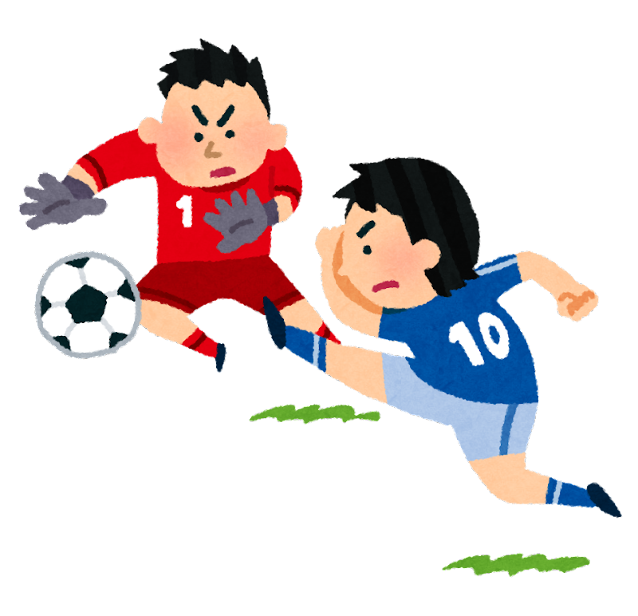
soccer team

Slide 3
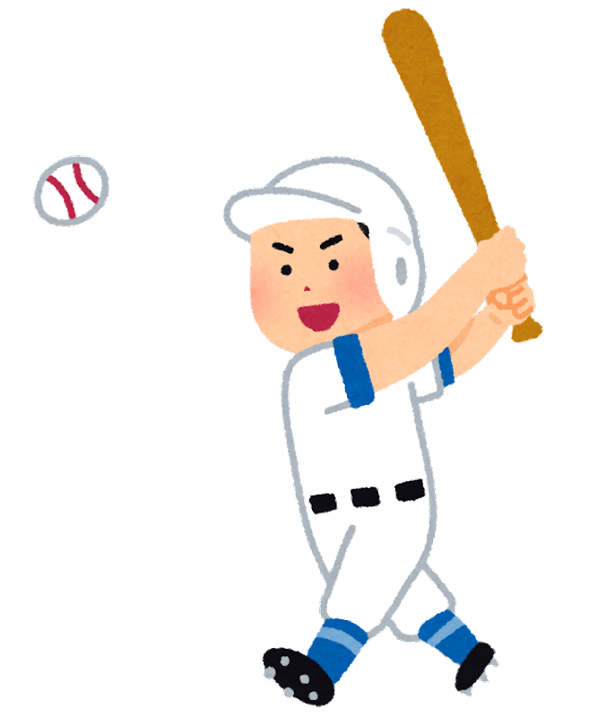
baseball team

Slide 4
basketball team

Slide 5
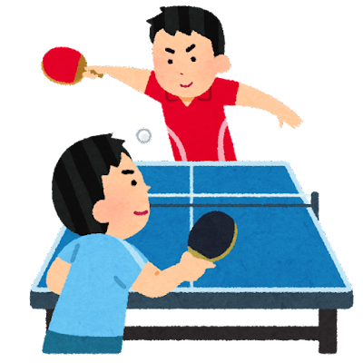
table tennis team

Slide 6
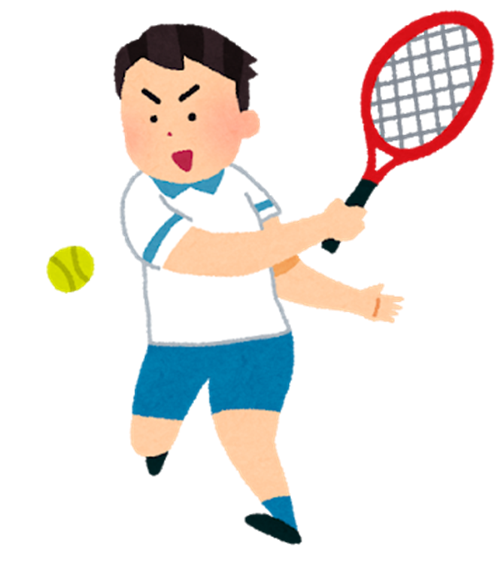
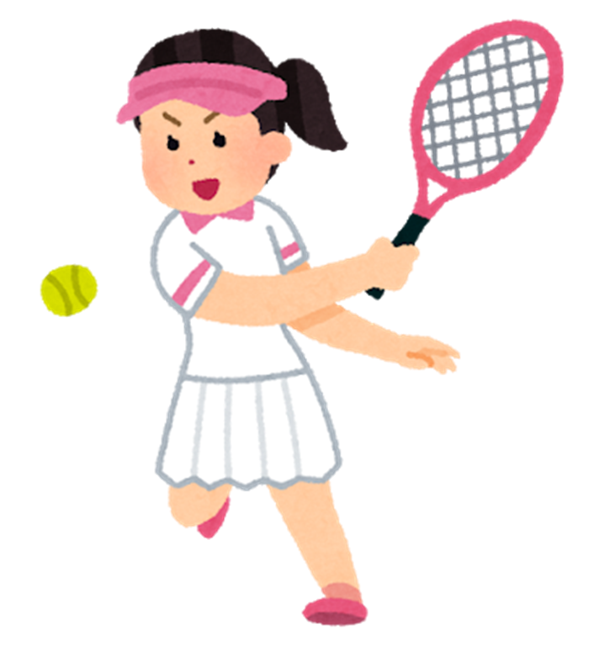
tennis team

Slide 7
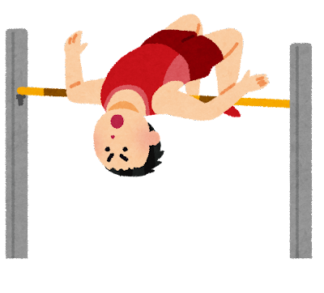
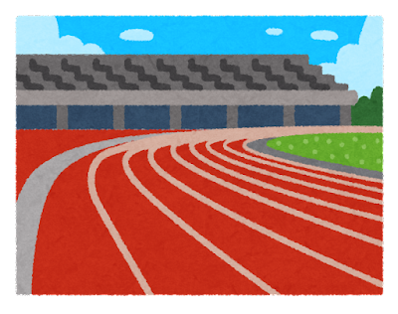
track and field team

Slide 8
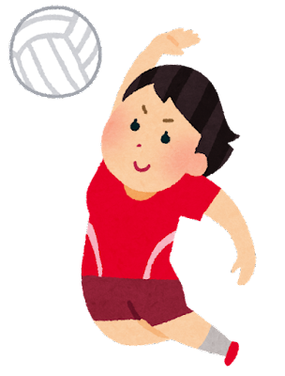
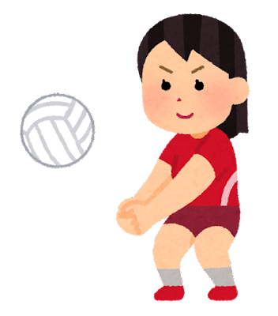
volleyball team

Slide 9
kendo team

Slide 10
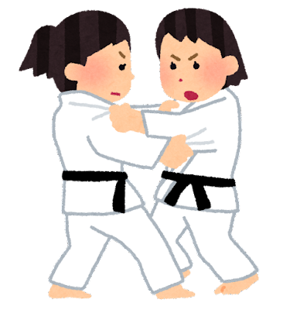
judo team

Slide 11
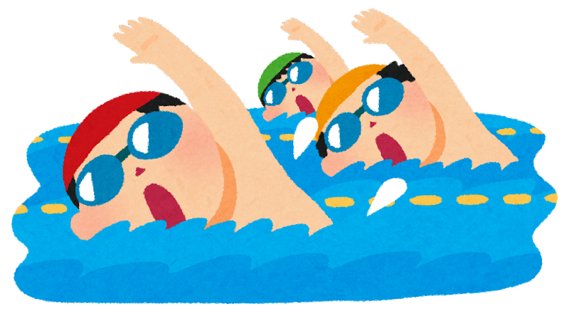
swimming team

Slide 12
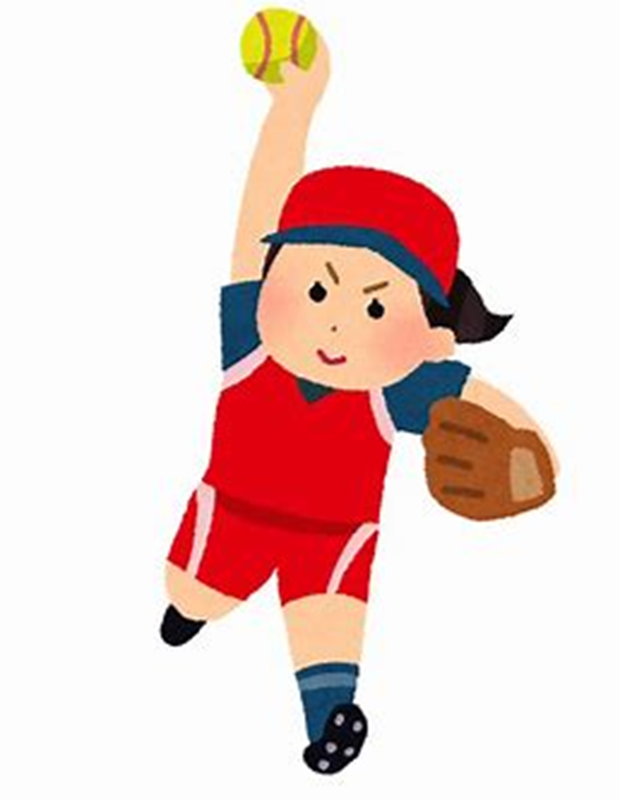
softball team

Slide 13
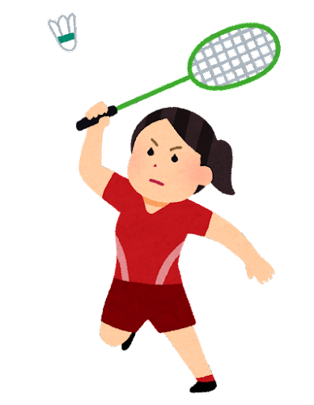
badminton team

Slide 14
dance team

Slide 15
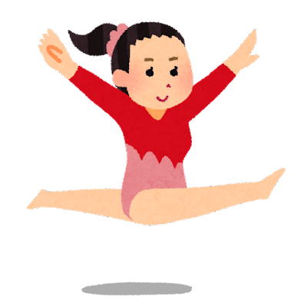
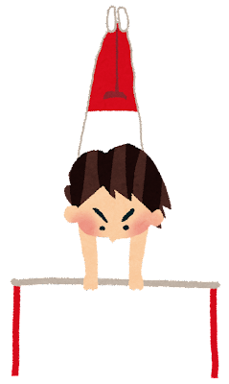
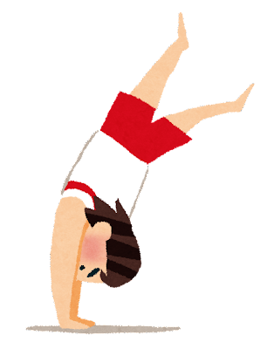
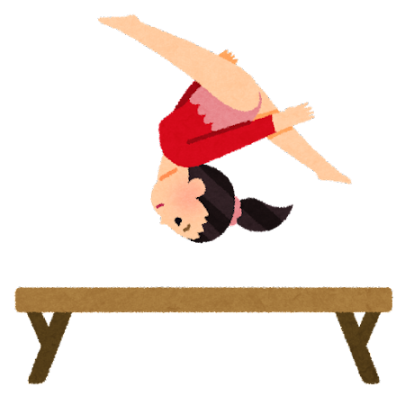
gymnastics team

Slide 16
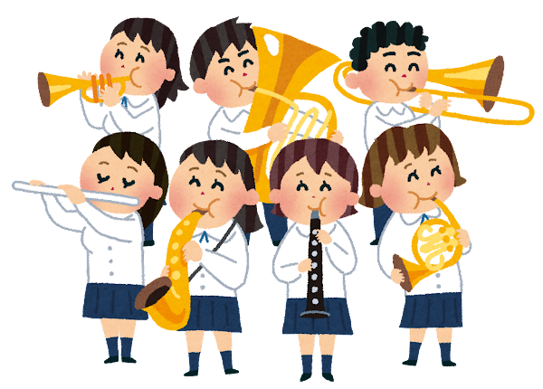
brass band

Slide 17
chorus

Slide 18
art club

Slide 19
broadcasting club

Slide 20
science club

Slide 21
tea ceremony club

Slide 22
home economics club

Slide 23
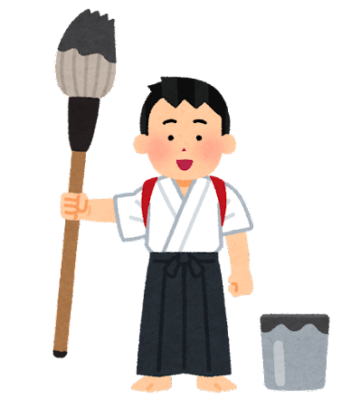
calligraphy club

Slide 24
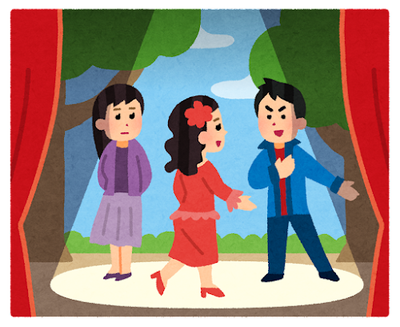
drama club

Slide 25
newspaper club

Slide 26
photography club

Slide 27
culture club

Slide 28
What club
do you want to join?
I want to join the ～ .

